Slide 1
AAMP and Subtec

Slide 2
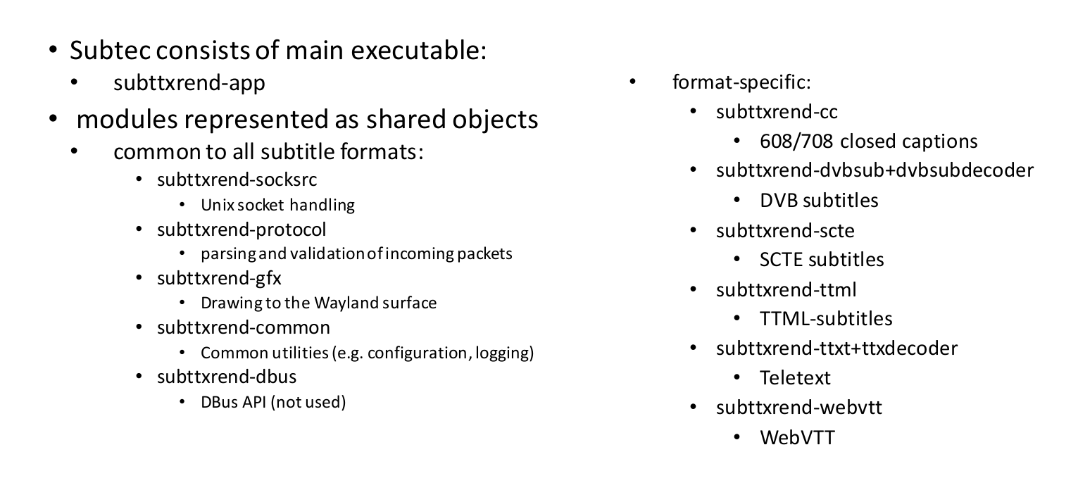
Subtec components

Slide 3
AAMP Simulator and Subtec
Build with install-aamp.sh which also builds subtec and all subttxrend* shared objects along with the subttxrend-app executable.
Build just subttxrend* with aamp/subtec-app/subttxrend-app/x86_builder/build.sh
Run with aamp-cli and command "subtec" - runs aampcli-run-subtec.sh
Uses Weston to render subtitles in a separate window.
On Ubuntu 22.04 have to set Weston backend to "x11-backend.so" in the aampcli-run-subtec.sh to display the window.
Playing a stream with out-of-band subtitles TTML or WebVTT will render the subtitles on that window.
In-band closed captions do not work currently on AAMP simulator – requires patches on RDKAAMP-420

Slide 4
Subtec on a device
Building and using subttxrend* components on a build in a container for a box is slightly different than for the AAMP simulator.
All subttxrend* components are present at top level, but within each one are all the others as well. Editing is only on the top level one to reflect on the built .so or subttxrend-app.
Deploy the changed .so to the box, restart subttxrend-app and then restart JSPP and changes should reflect on the box.
Logging is in /opt/logs/subttxrend-app.log

Slide 5
Subtec debug
Modules are divided into REND, CORE and GFX sections - these are listed in the componentToGroup map in subttxrend-common
Log levels for these groups are controlled from /etc/debug.ini from the LOG.RDK.SUBS.* directives (default INFO)
Finer-grained control is possible in /etc/subttxrend/config.ini using a LOGGER.LEVELS.component.element directive
These can be found in subttxrend source wherever a logger object is instantiated - i.e.
  m_logger("App", "Application", this) where App is the component and Application is the element

Slide 6
HLS/DASH, in-band/out-of-band subtitles
In general DASH uses TTML, HLS uses WebVTT (both out-of-band) mostly on the legacy Italian boxes.
There's also an option for WebVTT contained in sidecar data.
In-band CCs (608/708 muxed on the video PID) are on Platco-type projects.

Slide 7
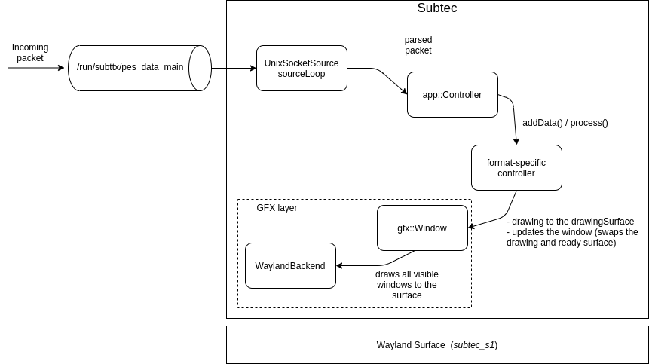
Subtitle rendering/composition
Incoming packets are immediately parsed and then passed to the data queue in the app::Controller thread.
The app::Controller thread forwards the control commands (mute, unmute, pause, resume) and data to appropriate format-specific controller.
The format-specific controller handles the control commands, processes the incoming data according to the format specification and draws to the drawing surface; updating the gfx::Window.
The GFX layer is responsible for drawing all visible gfx::Windows using the selected Wayland backend.

Slide 8
Subtitle config options
gstSubtecEnabled - switches gst support on and off, still needed on until RDK-40300 is resolved.
webVttNative - this should be removed. Subtec previously didn't have native WebVTT support, so an AAMP-based workaround was used. Native WebVTT support has since been added so this wouldn't be used anymore, so should always be true.
subtecSubtitle - this should be removed. Subtec is always used in AAMP for in-band subtitles, so should always be true.
NativeCCRendering - discuss if still needed. Possibly needed until everything done from subtec.
RDK-40307 - ticket for deprecating these configuration options

Slide 9
Gap preventing us from disabling dependency on gstreamer for AAMP/gst communication
Most things are working.
Similar issues to gst
  Sync issue following inserted ad on "Watch From Start" - LLAMA-9081
  Sync issues on some channels over ad breaks (i.e., ch. 125) - LLAMA-10920
Need to re-test some features that came in since (WebVTT data via sidecar, font size setting via API for HLS)
Changeset shared with Synamedia team (see RDK-40300)

Slide 10
Issues unique to multi period streams
Hard to sync the subtec clock with AAMP position on change of period.
The TIMESTAMP packet needs to be sent (with the correct time) just as the period changes so that it syncs properly. Solutions already being worked on LLAMA-9081, LLAMA-10920
The period discontinuity code in AAMP is slightly unusual, so we need to work around it.

Slide 11
Track advertising and switching
This is all taken care of in regular AAMP code using the same methods as for AV.
Options are taken from the incoming manifest and advertised to the player on the getAvailableTextTracks API.
Selected on tune.
Currently there is no way to swap subtitle tracks on the fly - switching track restarts the AV to sync everything up.

